Slide 1
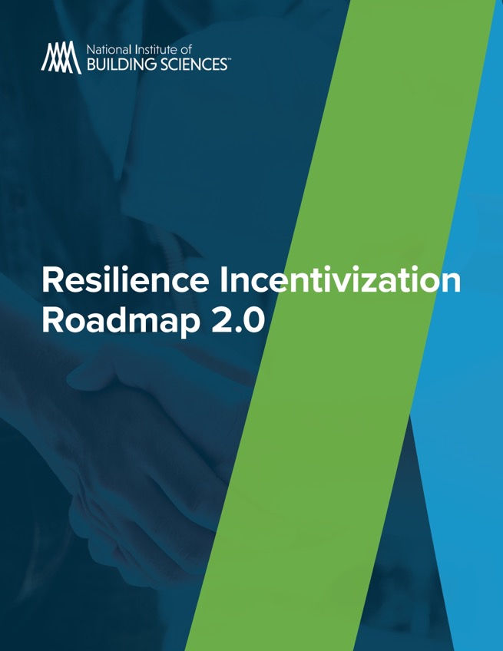
NIBS/Fannie Mae Resilience Incentivization Roadmap 2.0

Slide 2
Becketti: National hazard mitigation saves, but…
Problem: Externalities contribute to underinvestment in resilience
Homeowners (or developers) bear cost of resilience investments, but others share the benefits
Roadmap to Resilience 2.0 focuses on the example of flood risk, but lessons learned can be applied to risk of other natural disasters
Solution: Design incentives that co-beneficiaries can offer homeowners/developers to increase investment in resilience
Co-beneficiaries include insurers, lenders, securitizers, real-estate investors, real estate agents, communities and government
Properly-designed incentives can be win-win
Example: Insurer discounts premiums for resilient homes in exchange for reduced risk of flood damage
Proposed incentives should lead to pilot projects to confirm effectiveness

Slide 3
Becketti: Homeowners are the decision makers
Do homeowners recognize their risk?
Can at-risk homeowners identify effective resilience retrofits?
Can homeowners afford retrofits for resilience?
Many at-risk communities are less-affluent communities
Property-tax based incentives are relatively more effective for affluent homeowners
Financial incentives by themselves may not adequately incentive retrofitting for resilience.

Slide 4
Becketti: Designing financial incentives
Win-win incentives depend on extended periods of significant co-beneficiary risk
Portfolio lenders and securitizers face risk of delinquencies and default for the life of the mortgage.
In contrast, securitizing lenders face risk for less than a month (i.e., until they sell the mortgage)
Insurers face risk in year-long increments
Incentives are simpler to implement when co-beneficiaries interact directly with the homeowner or developer
Securitizers (e.g., Fannie and Freddie) can have significant impact on mortgage finance but do not interact directly with homeowners

Slide 5
Becketti: Where we ended: Top 3 proposals
Only one proposed financial incentive specifically for retrofitting in our top 3 proposals
GSEs purchase home equity loans that finance resilience investments
The other two:
Specific to new construction: Communities with elevated flood risk negotiate reduction in development impact fees in exchange for inclusion of resilience investments in new homes
Both new construction and retrofitting: Government tax incentives for resilience investments
Non-financial incentive proposals
Certification: Convene stakeholders to design a certification program for flood resilience investments (analogous to existing programs for wind risk)
Public awareness/education programs: To increase homeowner awareness of existing flood risk and to reduce uncertainty about appropriate resilience investments
Many additional proposals in the full report

