Slide 1


Retrofitting for Resilience
October 24, 2023
Robert Pekelnicky, SE
Senior Principal, Degenkolb Engineers
NATIONAL INSTITUTE OF BUILDING SCIENCES

Slide 2
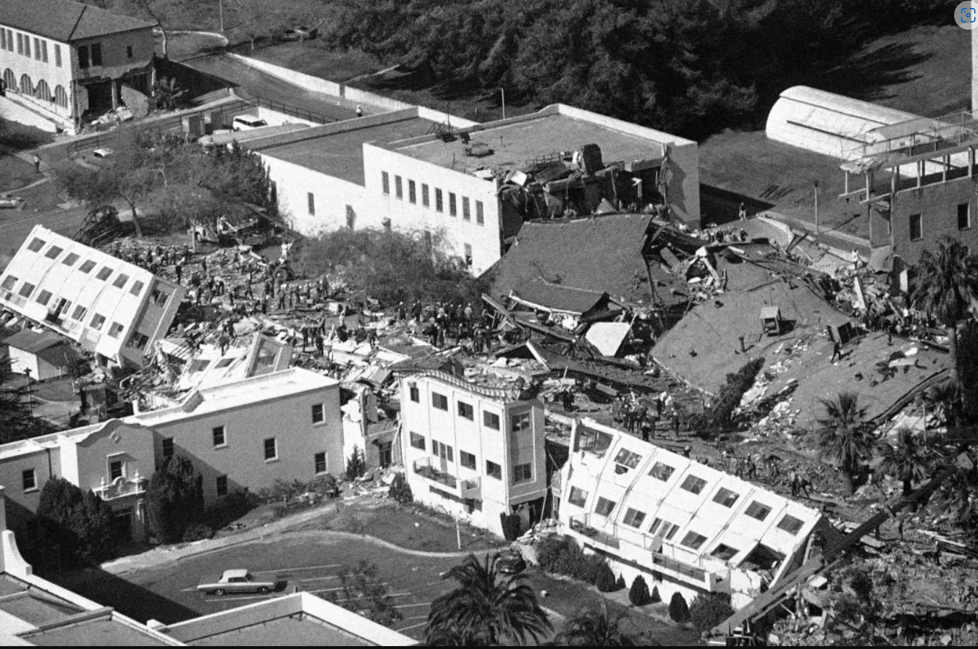
AP/Wally Fong
Title One
The Existing Building Challenge
Title One
Title Three

Slide 3
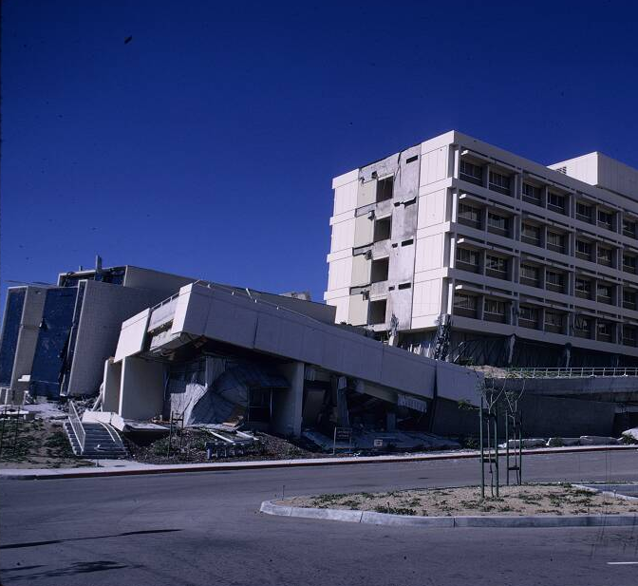
Earthquakes, floods, hurricanes, and tornadoes, demonstrate that code-conforming buildings can be inadequate.
Title One
Title One
Title Three
Figures courtesy of Degenkolb Engineers

Slide 4
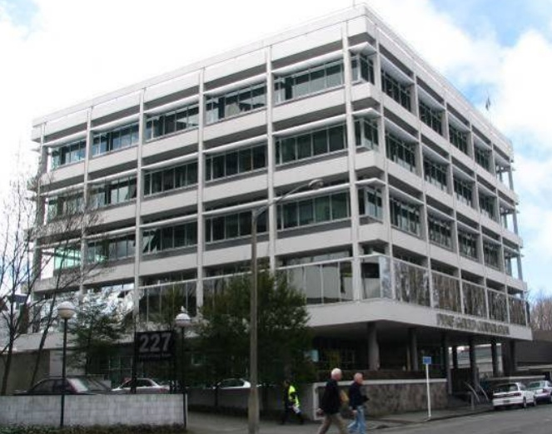
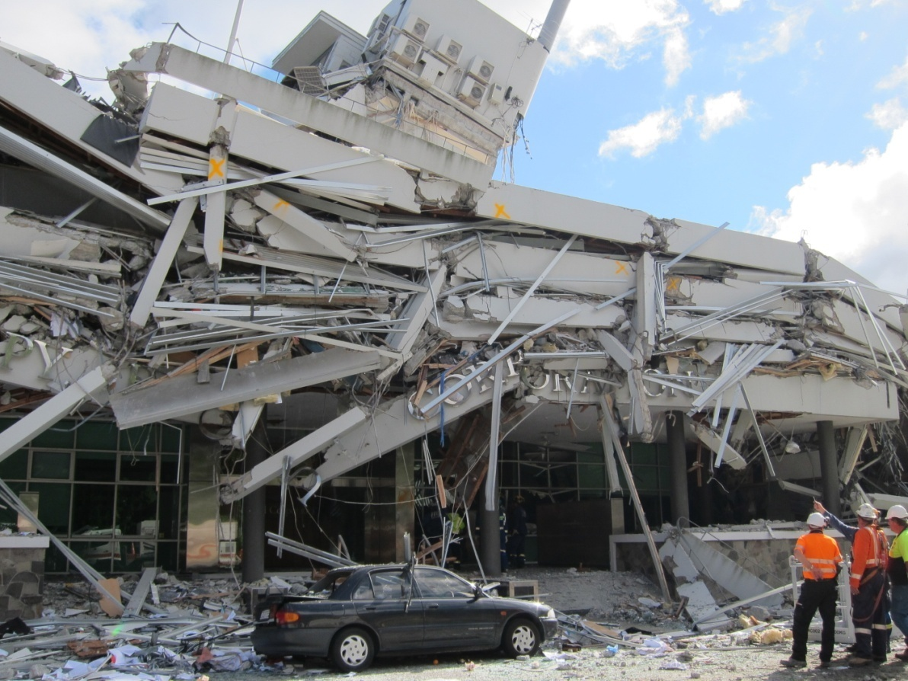
Where to draw the line for safety?
Pyne Gould Building – Christchurch, NZ
September 2010
Approx. 500-yr EQ
February 2011
Approx. 2,000-yr EQ

Slide 5
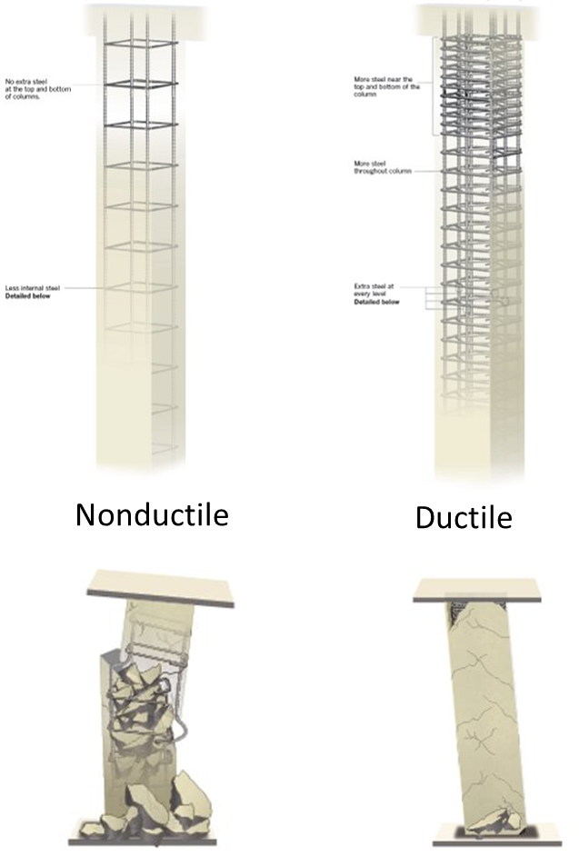
Research identifies ways to change building codes and standards to enhance resilience.

Slide 6
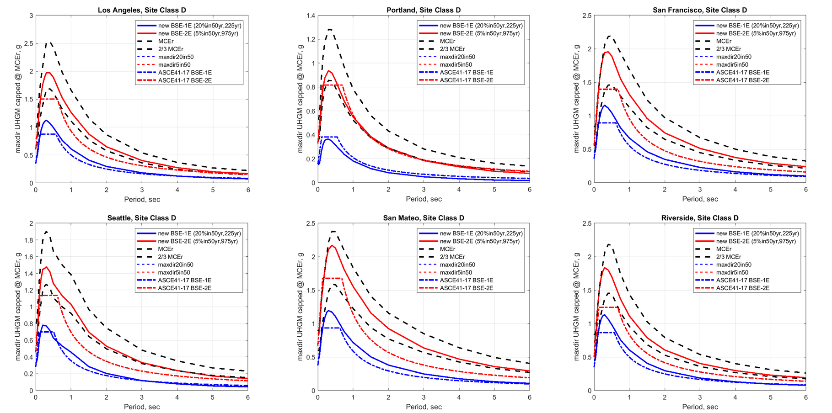
Our Understanding of Hazards Change

Slide 7
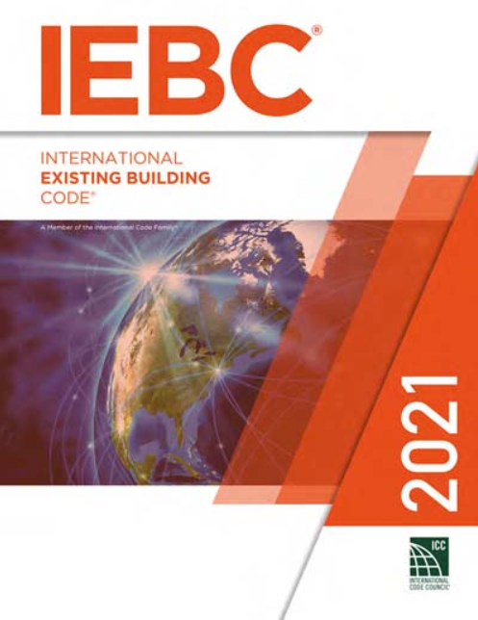
Title One
The Building Code Does not Require Retroactive Mitigation of Seismic Deficiencies*
Title One
Title Three

Slide 8
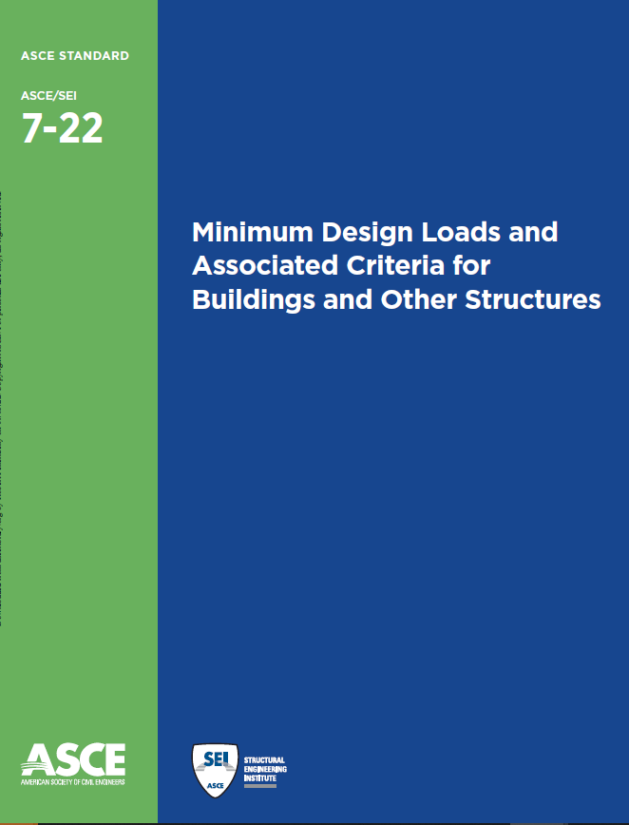

Slide 9
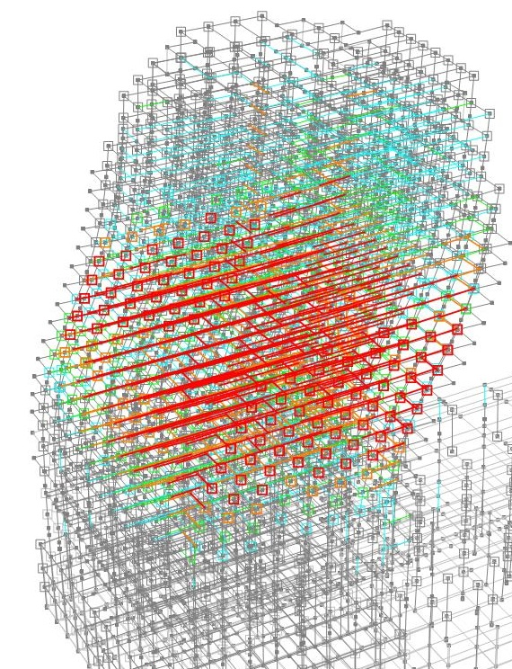
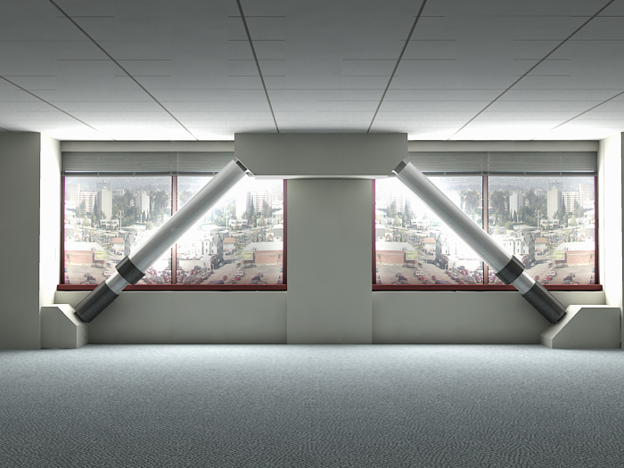
Meaningful Evaluations Are a Significant Expense
Most Existing Buildings Fail the Evaluations
Retrofits Can Be Prohibitively Expensive

Slide 10
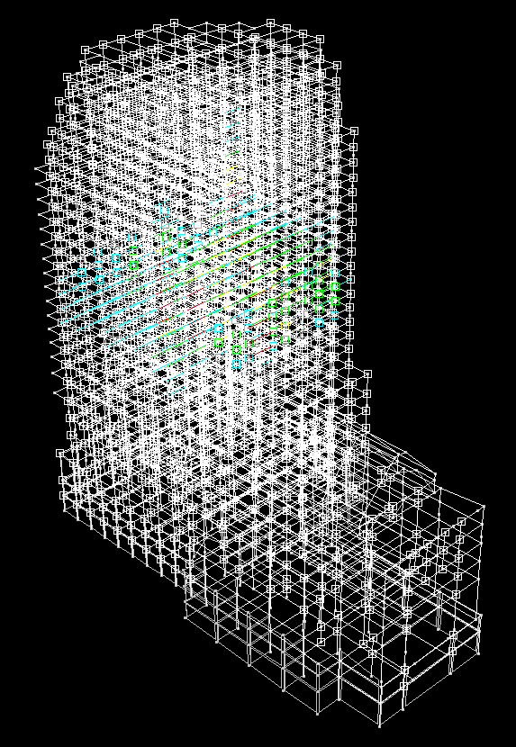
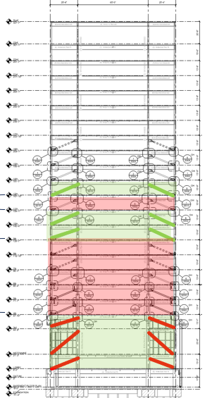
Improved Screening Tools
More Accurate Evaluation Methods
New Retrofit Objectives & Methods

Slide 11
Challenges:
Meaningful Evaluations Are a Significant Expense
Most Existing Buildings Fail the Evaluations
Retrofits Can Be Prohibitively Expensive
Opportunities:
Improved Screening Tools
More Accurate Evaluation Methods
New Retrofit Objectives & Methods

Slide 12

Discussions
Robert Pekelnicky, SE
Senior Principal, Degenkolb Engineers
NATIONAL INSTITUTE OF BUILDING SCIENCES

